Slide 1
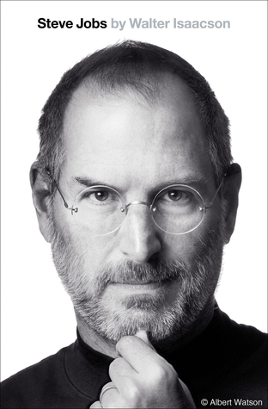


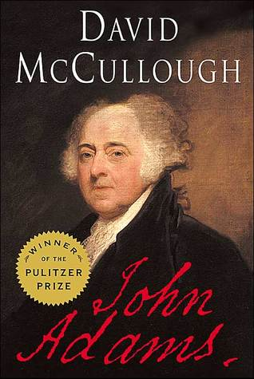
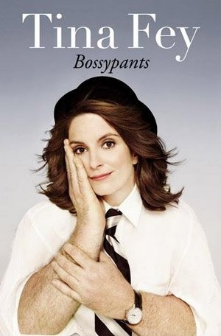
Book Sorting
Wei Ma

Slide 2
Scenario...
Searching book on book suggestion websites without the book title, just in a specific genre.
Goodreads: https://www.goodreads.com/
Amazon: https://www.amazon.com/books-used-books-textbooks/b?ie=UTF8&node=283155

Slide 3
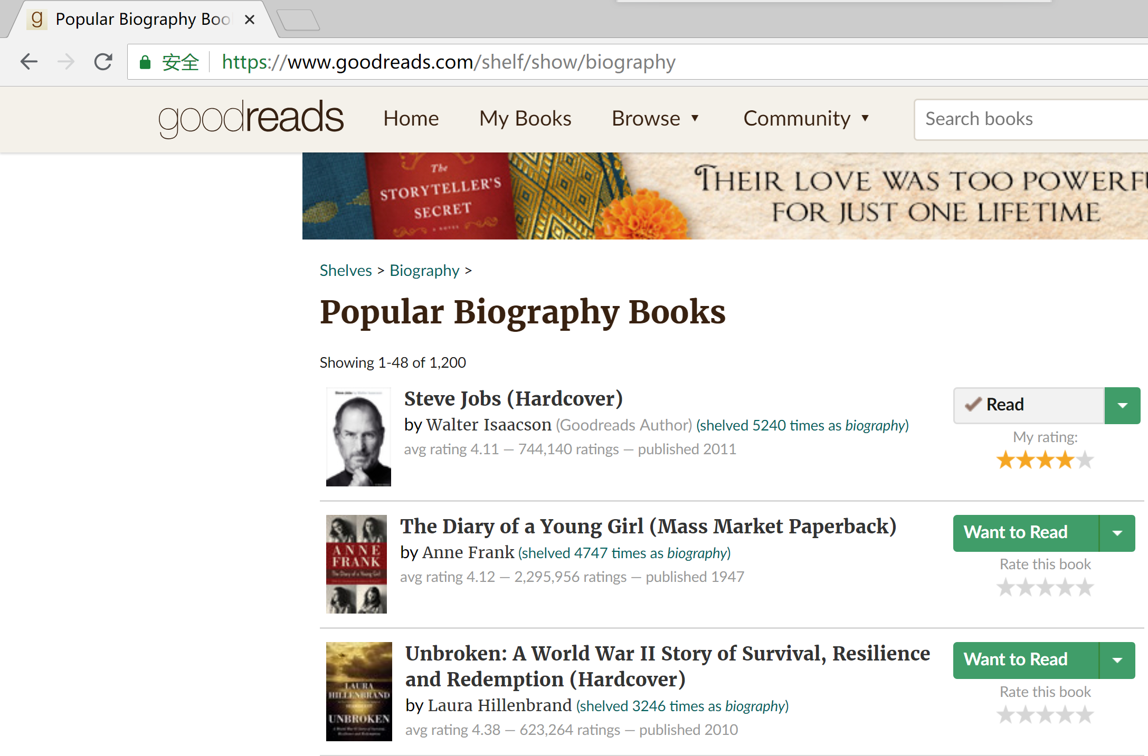
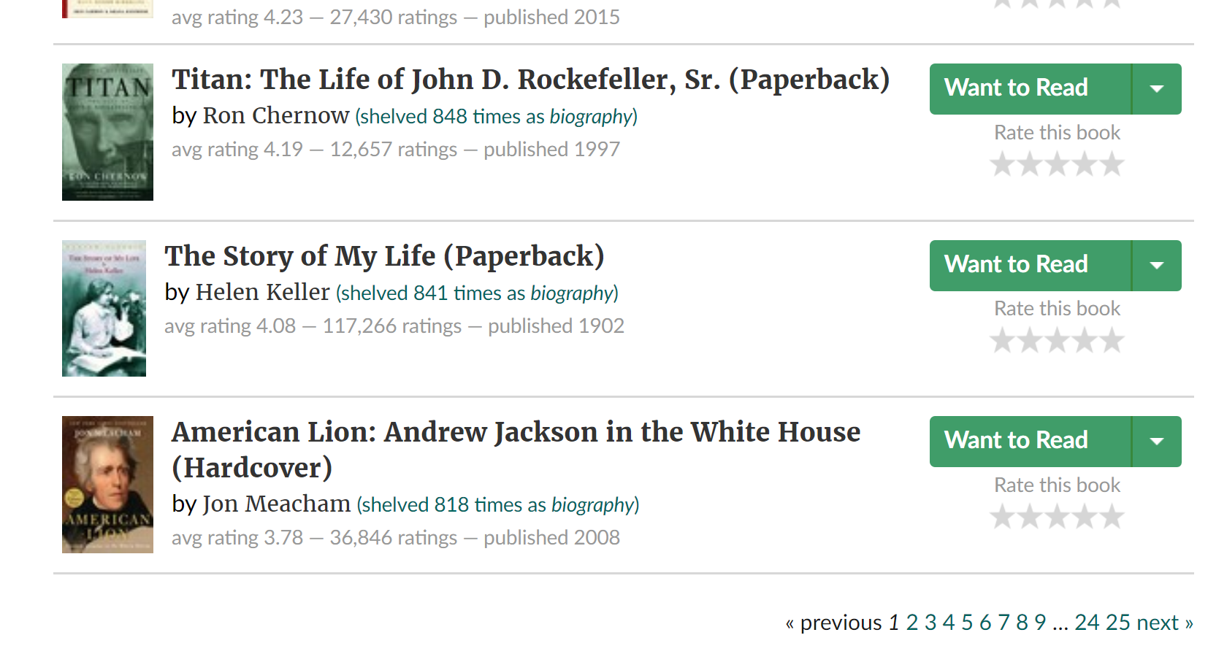
Problem...
Notes:
So my goal is to build a website that can rank those books in different attributes such as the average rating, the number of ratings and the publish year.

Slide 4
Django
Django is a Python-based free and open-source web framework, which follows the model-view-template (MVT) architectural pattern.
Django's primary goal is to ease the creation of complex, database-driven websites.
Reusability and "pluggability" of components, less code, low coupling, rapid development, and the principle of don't repeat yourself.

Slide 5
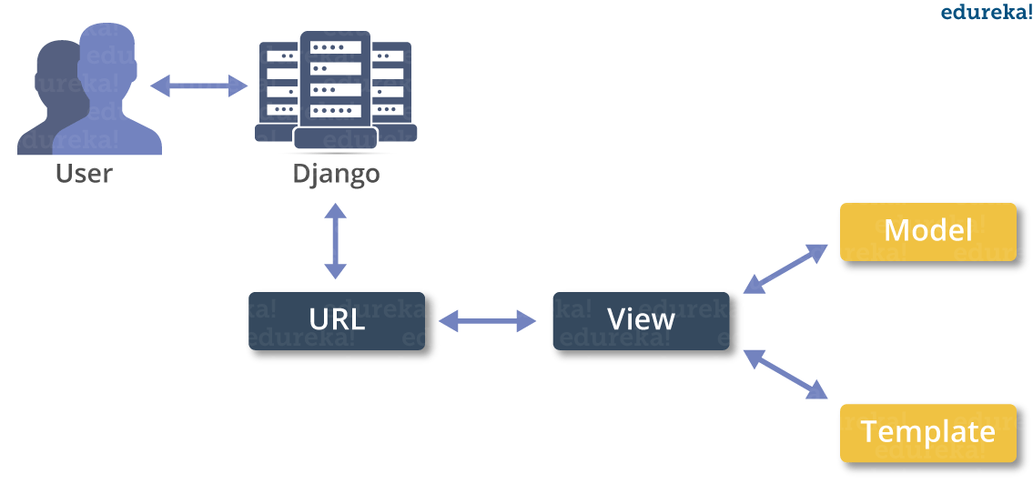
Django -- MVT
Models Describes your data
Views Controls what users see
Templates How user sees it
The paths that user can access.
Notes:
Model is a model of the data access layer. It defines how to access data, how to validate data, and what are the relationships between the data.
Template is the presentation layer. It defines how something should be displayed on a Web page.
View is the business logic layer. It defines the logic that access the model and references the appropriate template.

Slide 6
http://booksort-env-2.kir74pueej.us-east-2.elasticbeanstalk.com/

Slide 7
Summary & Future work
Django
Built website
Dynamically request data from database
HTML+CSS+JS
More genres, more books
Further functions on my website

Slide 8
Questions ?

